Slide 1

The Harlem Renaissance Artists

Slide 2
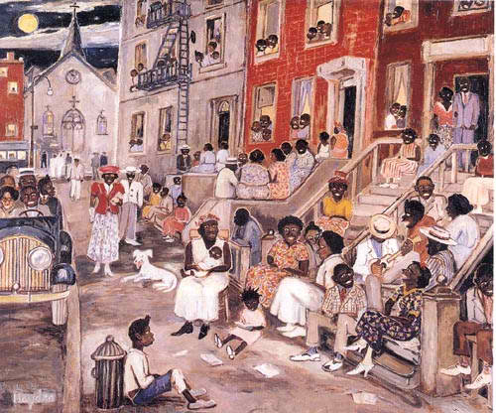
Harlem, New York

Slide 3
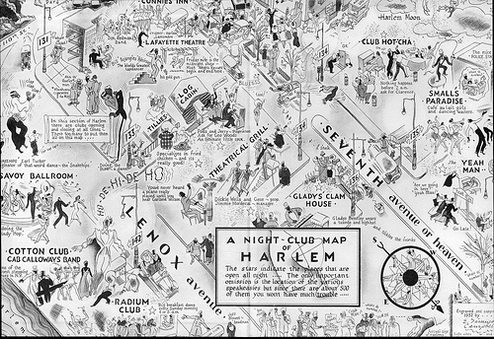
Map of Harlem during the Roaring 20s
Growing neighborhood north of Central Park with the Great Migration: better education, jobs, and racism not as severe
New York: publishing capital of Western hemisphere, major port, financial & cultural capital
Center of African American cultural awakening: intellectuals, musicians, writers, artists, business which influenced others such as Picasso

Slide 4
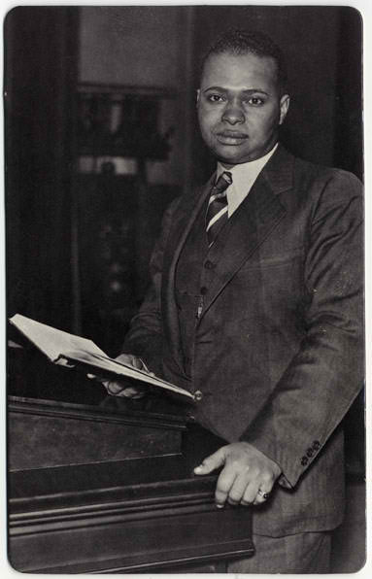
Countee Cullen 1903 – 1946
raised by Reverend Frederick A. Cullen,
pastor of one of Harlem’s largest
congregations.
formal education in predominately white
schools, head of newspaper & writing
success early on; New York University &
Harvard for master’s
informal education the streets of Harlem,
African American arts, culture
success in both black and white cultures;
believed art transcended race, minimize the
racial barriers

Slide 5
Countee Cullen’s Work
Heritage
What is Africa to me:
Copper sun or scarlet sea,
Jungle star or jungle track,
Strong bronzed men, or regal black
Women from whose loins I sprang
When the birds of Eden sang?
One three centuries removed from the scenes his fathers loved,
Spicy grove, cinnamon tree,
What is Africa to me?
What is Cullen’s
message?
Describe the use of “or” in this poem.
What is the difference between the repeated phrase at the beginning and the end of the poem?
How does the poem help you understand why the last line differs?
How might Mr. Cullen’s background help influence the creation of this poem?
Identify:
Imagery
Emotions
Vocabulary

Slide 6
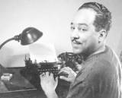
Langston Hughes 1902-1967
Raised by grandmother and mother, father left early to look for work
First visit to Harlem freshman year at Columbia University, graduated from Lincoln University
19 years old published first poem
Strong commitment to social justice; early writings optimistic about social and political equality, later writings frustrated at the progress of civil rights
Used humor not violence, not regarded as role model
Carl Sandburg & Walt Whitman primary influences
Weary Blues, incorporating jazz into his poetry
The poet is not only a dreamer, but a dream keeper

Slide 7
Langston Hughes’ Work
Words Like Freedom
There are words like Freedom
Sweet and wonderful to say.
On my heartstrings freedom sings
All day everyday.
There are words like Liberty
That almost make me cry.
If you had known what I know
You would know why.
What is Hughes’ message?
The words freedom and liberty have very similar meanings. Based on your knowledge of this time period, describe why they are used differently in this poem.
How might Hughes’ background help influence the creation of this poem?
Identify:
Emotions

Slide 8
Merry-Go-Round
Where is the Jim Crow section
On this merry-go-round,
Mister, cause I want to ride?
Down South where I come from
White and Colored
Can’t sit side by side.
Down South on the train
There’s a Jim Crow car.
On the bus we’re put in the back ---
But there ain’t no back
To a merry-go-round!
Where’s the horse
For a kid that’s black?
What do we learn about the poet’s past and present from this poem?
What words and phrases help you to understand this?

Slide 9
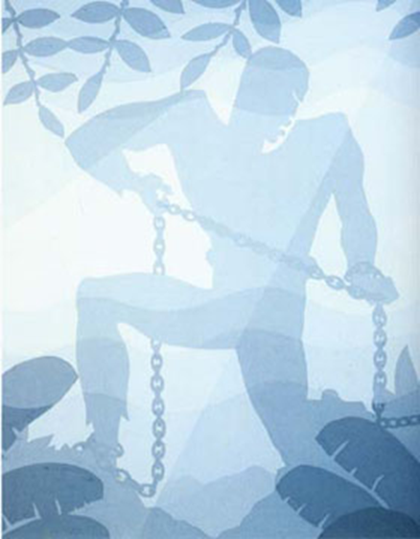
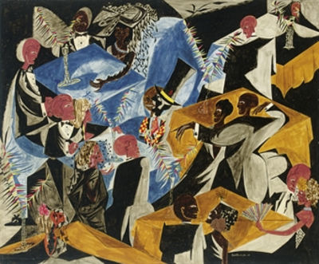
Art Knows No Racial Barriers
Jacob Lawrence 1917-2000, parents part of Great Migration, mother settled in Harlem. Paintings on life of Frederic Douglass & Harriet Tubman, served in WWII.
Aaron Douglas 1898-1979, study for God's Trombones, part of a four panel series, the African American journey: home, enslavement, freedom

Slide 10
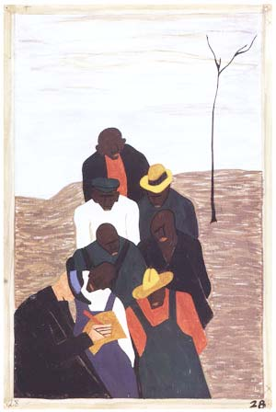
Art Knows No Racial Barriers
Agents for Northern factories went south to recruit workers
  From The Great Migration series by Jacob Lawrence

Slide 11
Essential Questions
To A Brown Boy by Countee Cullen
I, Too, Sing America and Harlem by Langston Hughes
How are these poems reflective of the authors’ point of view?
How do these poems reflect the cultural attitudes and beliefs of the time period?

